Slide 1
VIRTUAL PEN THEME AI (OpenCV)
BY
AAMIR P
PANIMALAR ENGINEERING COLLEGE, CHENNAI, INDIA

Slide 2
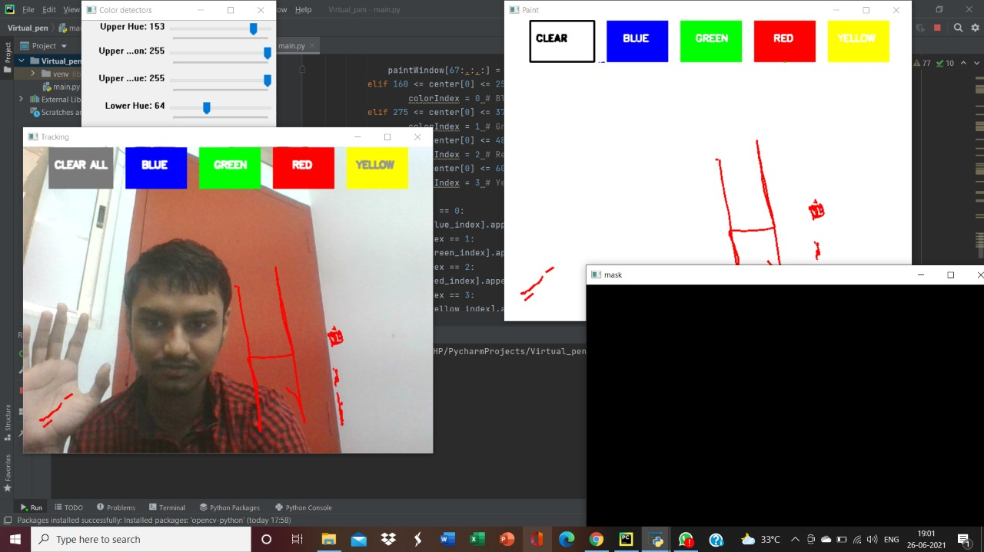

Slide 3
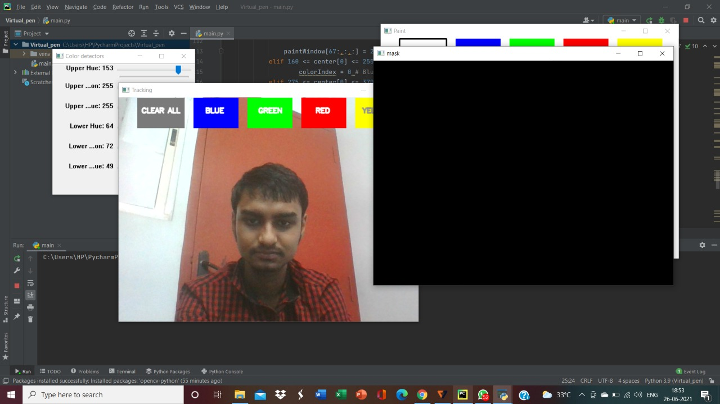
I have used the concept of OpenCV(AI) to do this project! As lockdown is extending, our staff are finding it difficult to use paint instead of the blackboard. This will be useful to them.

Slide 4
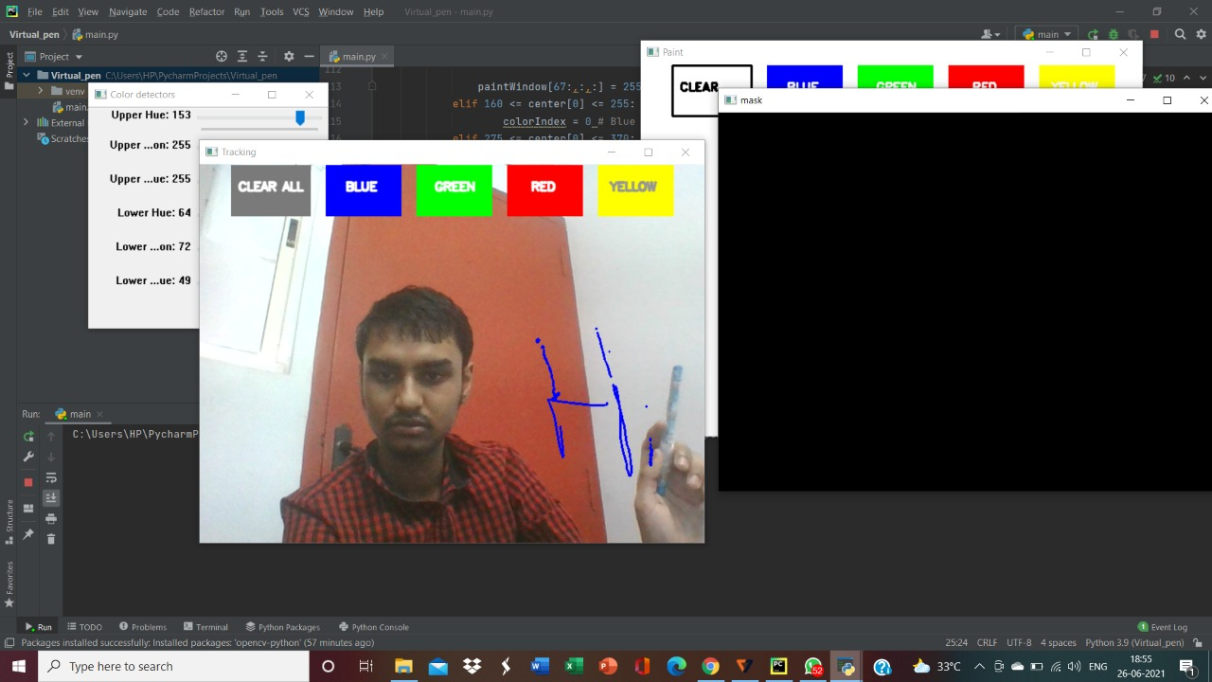
This project will be useful to the staff to teach instead of using paints which lands up as scribbling. Even for work from home people to explain their presentations, this would be a useful tool.

Slide 5
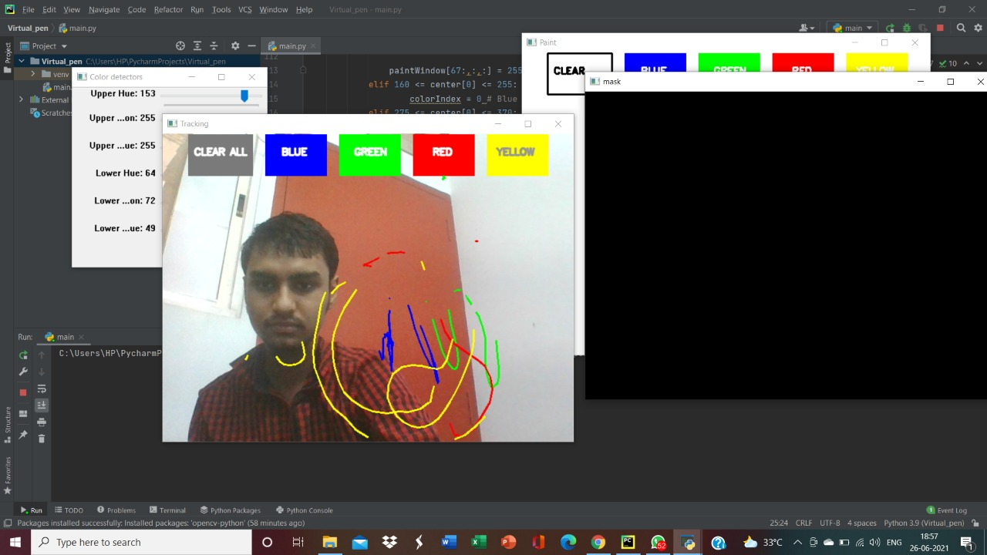
The bug was AI was recognizing the pen in its own ways. So, I taped the body of the pen and left the tip of the pen without taping. Now, the software was able to recognize the correct pointer of the pen that is the tip of the pen. Light needs to fall on you.

Slide 6
THANK YOU
Hack The Mountains 2.0
Sponsors
Mentors
Ambassadors
And
All supporting teams

